Slide 1
Regular Expressions and Automata
Jordan Dehmel

Slide 2
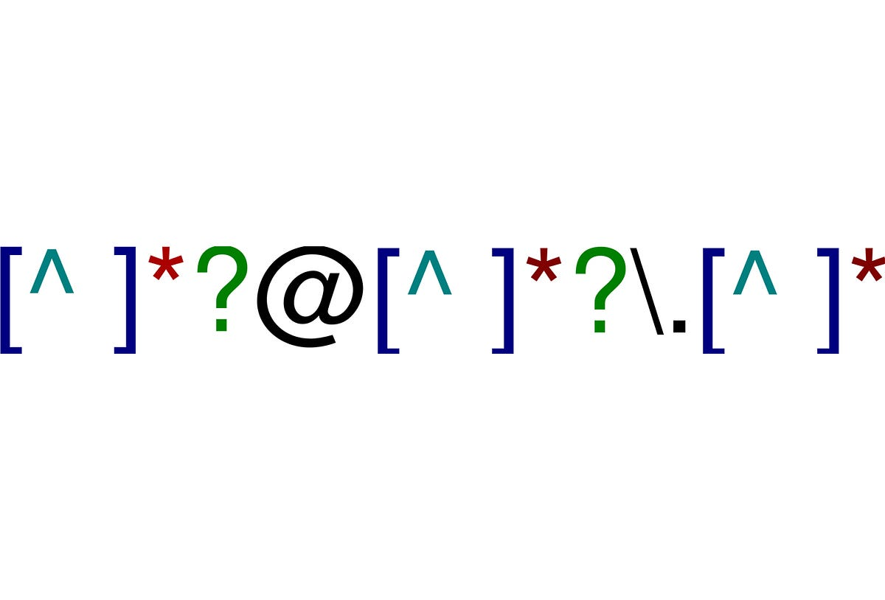
Regular Expressions
Match sets of strings, called "languages"
Languages distinguishable by RegEx are called regular
Primarily used for searching or matching
Can be interpreted or compiled to DFA
Image via medium.com

Slide 3
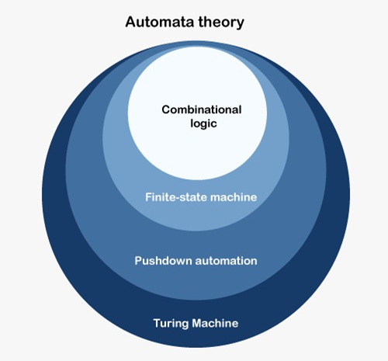

Automata
Abstract model of computing
Singular is "automaton"
Hierarchy of automata
Combinatorial logic
Boolean logic
Can add numbers
Finite automata
DFA, -NFA, NFA, RegEx
Lexers / parsers
Can match regular languages
Pushdown automata (PDA)
Grammar recognizers
Can match context-free grammars
Turing-complete automata
Turing machine, register machine, Von Neumann machine
Can perform any calculation
Image via tutorialandexample.com

Slide 4
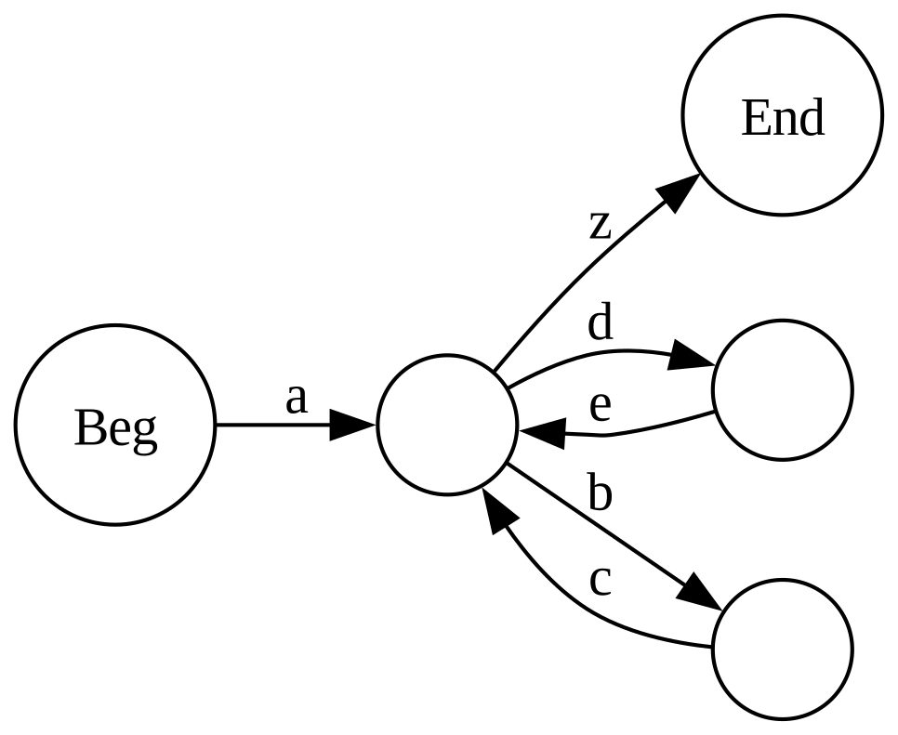
DFA (Deterministic Finite Automata)
Represented by a digraph
Vertices are states
Edges (transitions) consume 1 input each
Next state is a function of current state and input

Slide 5
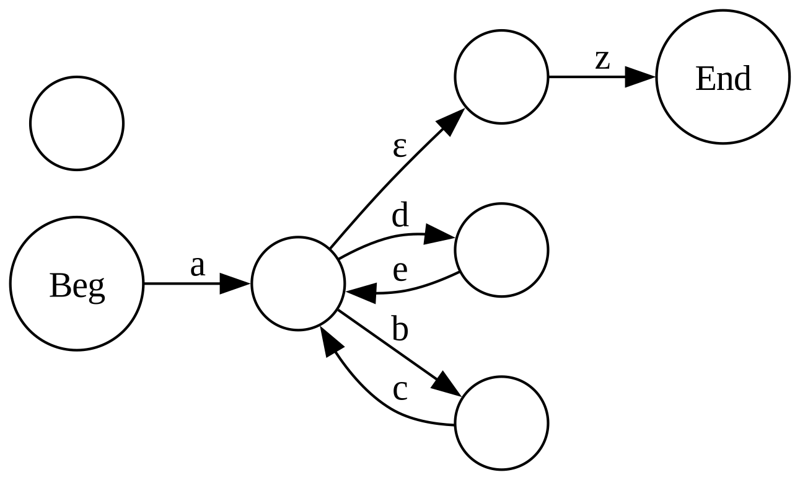
Epsilon-NFA (Nondeterministic Finite Automata)
Nondeterministic finite automata with epsilon ( ) transitions
transitions
These are non-consumptive
Can be erased via closure, making it a DFA
NFA and DFA are equivalent

Slide 6
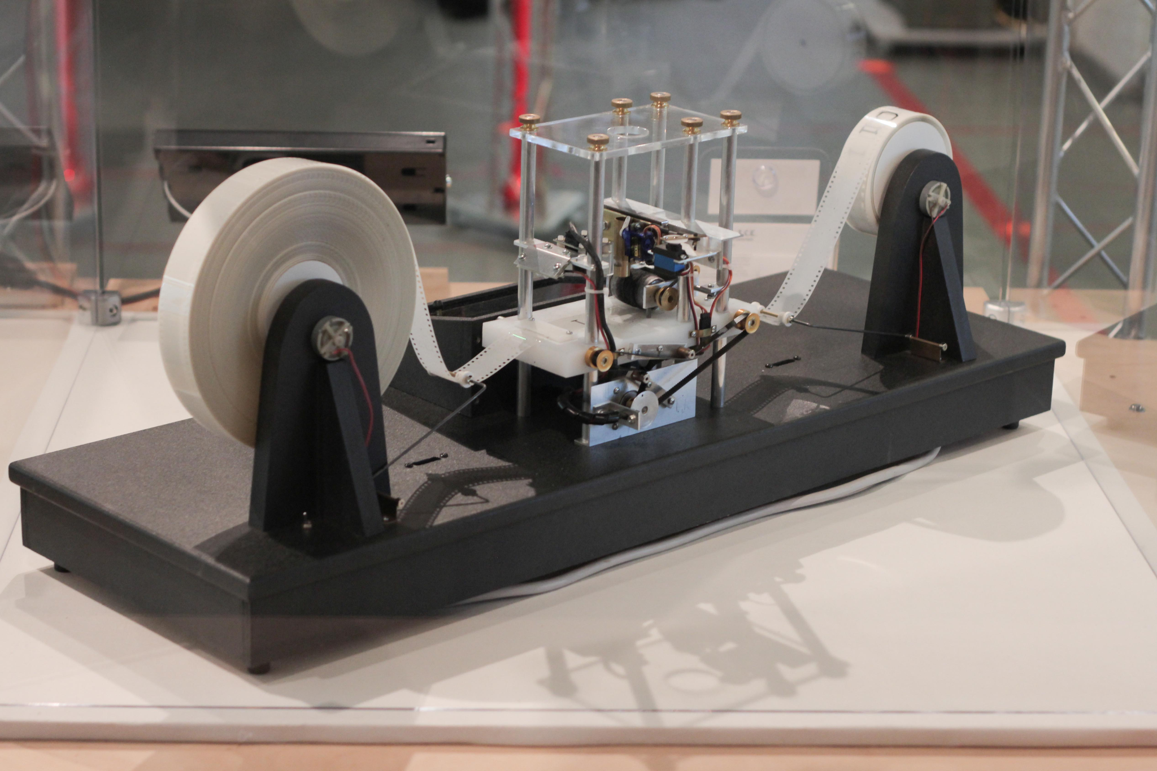
Why compile RegEx?
Uncompiled RegEx
Human readable
Computationally inefficient
-NFA
Easy to build and assemble algorithmically
Computationally inefficient
DFA
Efficient
Human readability: RegEx
Computation efficiency: DFA
Image via wikiwand.com

Slide 7
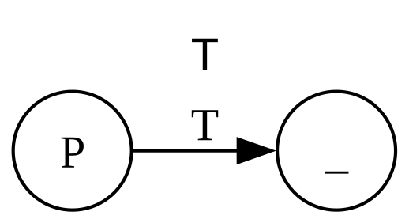
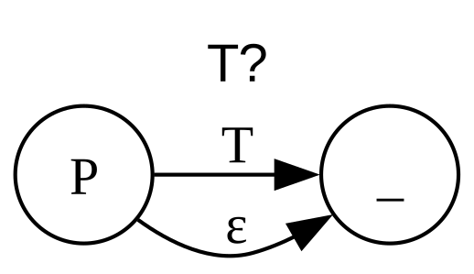
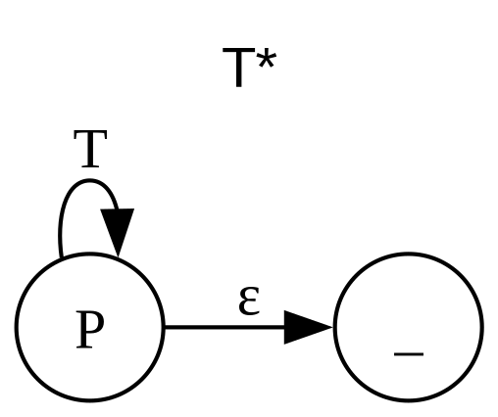
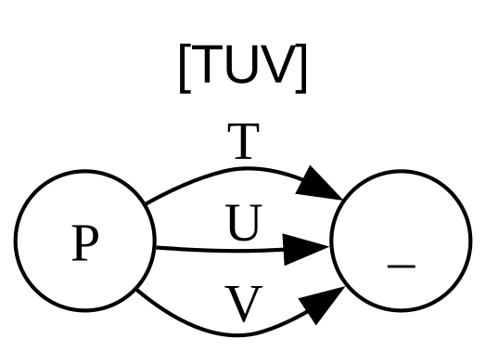
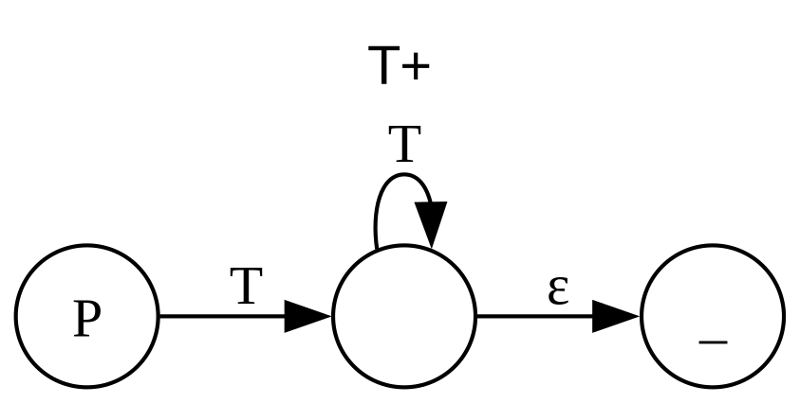
How to Compile RegEx
Break RegEx into subexpressions
Compile subexpressions into . - NFA
Link -NFA subexpressions into one . - NFA
Perform epsilon closure to bring . - NFA to DFA

Slide 8
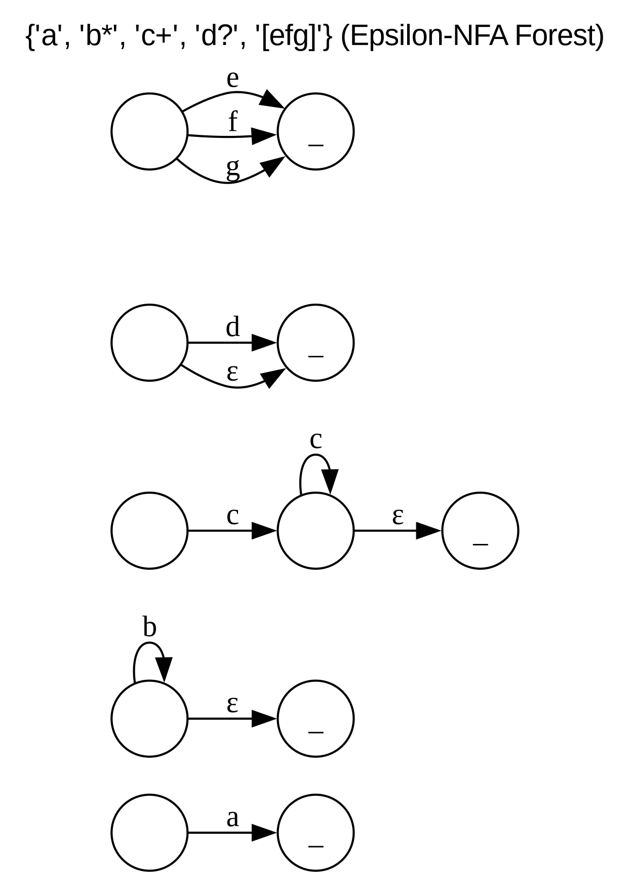
Example
Uncompiled RegEx: /ab*c+d?[efg]/
Break into subexpressions
/a/
/b*/
/c+/
/d?/
/[efg]/
Compile subexpressions into epsilon-NFA forest (image on right)

Slide 9
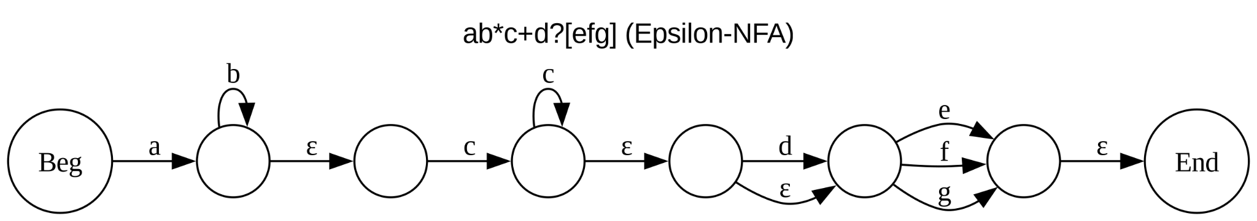
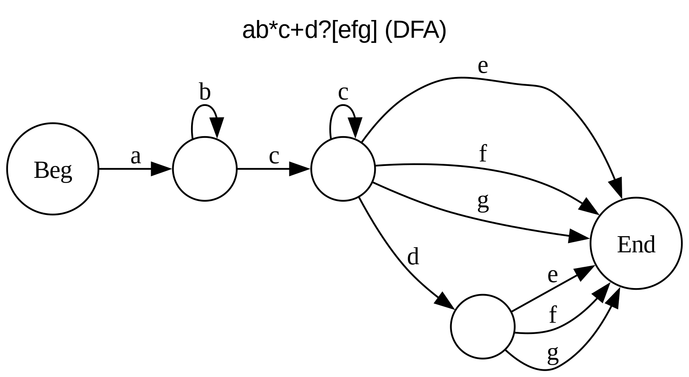
Link subexpressions
Top image
Remove epsilon transitions
Bottom image
We now have a compiled DFA!

Slide 10
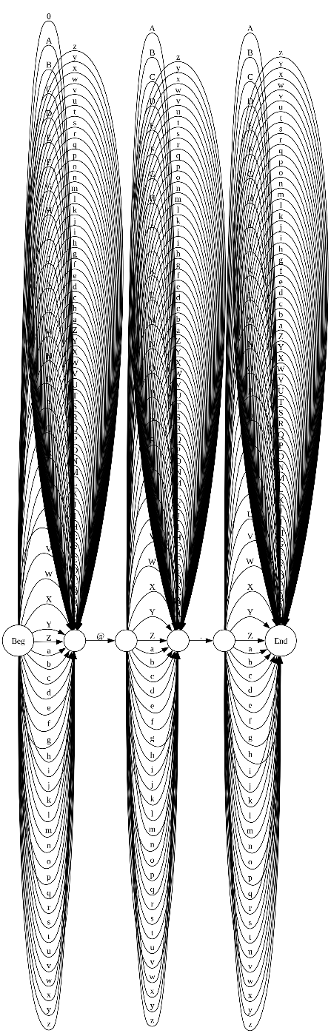
Example: Email Validation
/([a-zA-Z_]|[0-9])+@[a-zA-Z_]+\.[a-zA-Z_]+/
Image is fully expanded DFA
Compiled by custom script (see later)

Slide 11
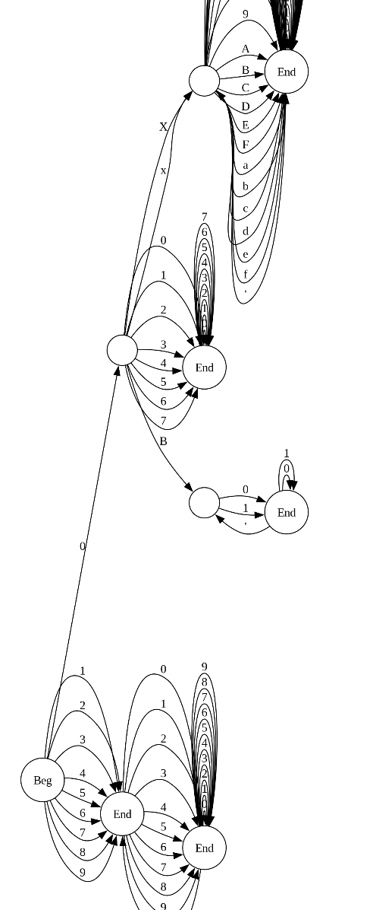
Example: C++ Integer Literals
/(0(x|X)((a|b|c|d|e|f|A|B|C|D|E|F|0|1|2|3|4|5|6|7|8|9)+')*(a|b|c|d|e|f|A|B|C|D|E|F|0|1|2|3|4|5|6|7|8|9)+|-?(1|2|3|4|5|6|7|8|9)((0|1|2|3|4|5|6|7|8|9)+')*(0|1|2|3|4|5|6|7|8|9)+|(0|0((0|1|2|3|4|5|6|7)+')*(0|1|2|3|4|5|6|7)+)|0(b|B)((0|1)+')*(0|1)+)/
(some transitions are cropped out for visibility)

Slide 12
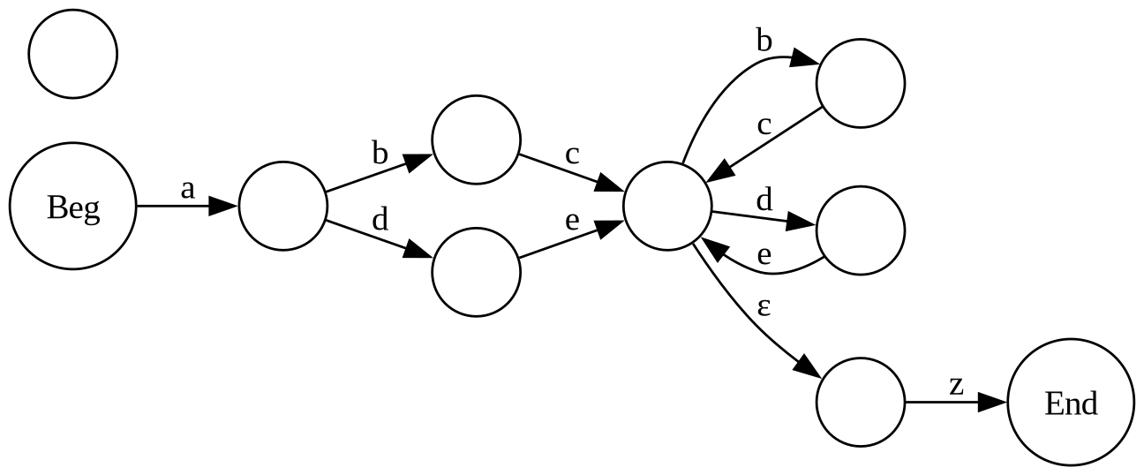
RegEx Extensions
Composable RegEx
Where patterns can call other patterns
Recursive RegEx
Where patterns can call themselves
Roughly equal to PDA
Token-based RegEx
Replace characters with tokens
For token stream pattern matching
Capture groups
Extracting information
RegEx pattern transformations
Find + replace by pattern

Slide 13
RegEx Compiler
Code Demo
Notes:
Show tokex and regex source code, then regex demo, then tokex demo, then lexer. Then conclude. Codebase is ~2,900 loc.

Slide 14
Sources
https://cstaleem.com/epsilon-nfa-%E2%88%88-nfa
https://brilliant.org/wiki/pushdown-automata/
https://people.eecs.berkeley.edu/~sseshia/172/lectures/Slides3.pdf
https://www.rexegg.com/regex-recursion.html
https://www.tutorialandexample.com/what-is-automata-theory (image)
https://miro.medium.com/v2/resize:fit:1200/0*k1PvoQAQ5fsuwEIk.jpg (image)
https://www.wikiwand.com/simple/Turing_machine (image)
Node diagrams by J. Dehmel, CMU 2024 via GraphViz
No AI was used in this project

